Slide 1
Switching horses midstream: the challenge of migrating 150+ services to kubernetes
Sarah Wells
Technical Director for Operations and Reliability, Financial Times
@sarahjwells
Notes:
Hi, I’m here to talk about migrating a complex, distributed and live system between technology stacks.

Slide 2
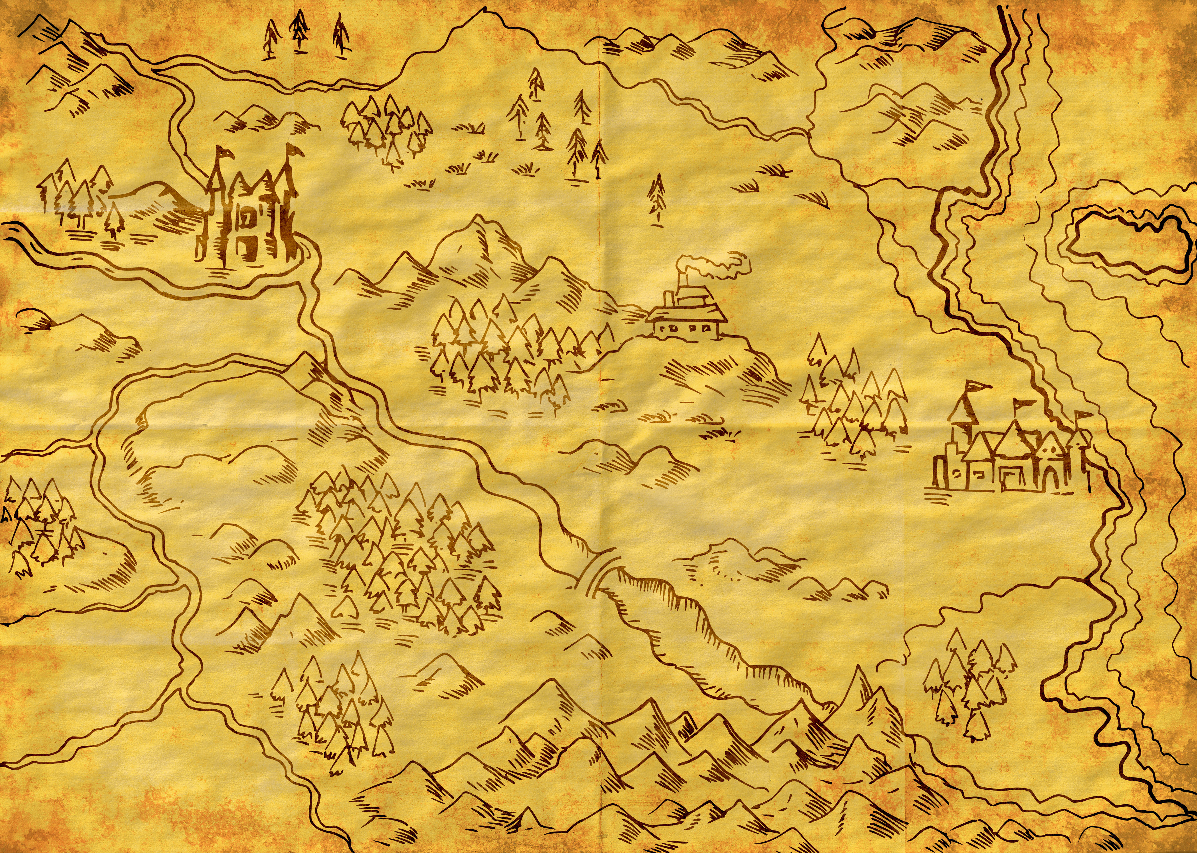
Notes:
We often give technical talks as though the change we went through was a journey. We set out to do this thing, and along the way we faced some difficulties but we got to our destination in the end and it was great.
But I don’t think that’s what it’s really like. I think that’s because we’re looking back after the event.
We don’t necessarily know where we are going. We have a destination in mind but it’s more like we’ve heard about this city where the streets are paved with gold and it’s somewhere over in this direction…

Slide 3
Notes:
And mostly, we don’t start out from home - it’s really rare to be starting completely from scratch - even when you’re working on something new you only get to have no baggage *right* at the very beginning…
And almost always, the previous decisions we’ve made have a big impact on what we can do and how difficult things will be. We likely made those decisions for the best of reasons, but they can hurt us later

Slide 4
Notes:
The Financial Times describe ourselves as one of the world’s leading news organisations. We don’t describe ourself as a newspaper although we do print a paper - and that’s because most of our readers read the FT online via their laptop or phone.
We also have a sophisticated subscription model and paywall.
Which means technology is essential to our business.

Slide 5
Empowered teams
Notes:
The FT has several different groups within technology, and those groups are empowered to make their own decisions about the technologies they use. That means different teams use very different technologies.

Slide 6
Notes:
You can think of it as a pendulum. From effectively totally separate autonomous teams at one end, to everyone deploying on the same platform and using the same programming language, maybe the same repo on the other.
We’re nearer the left hand side of this pendulum than the right, but we are moving back towards the centre.
And where we think the balance point is, has changed over the last few years. We diverged out, and now we are settling on a couple of different options, right for particular requirements and particular teams.

Slide 7
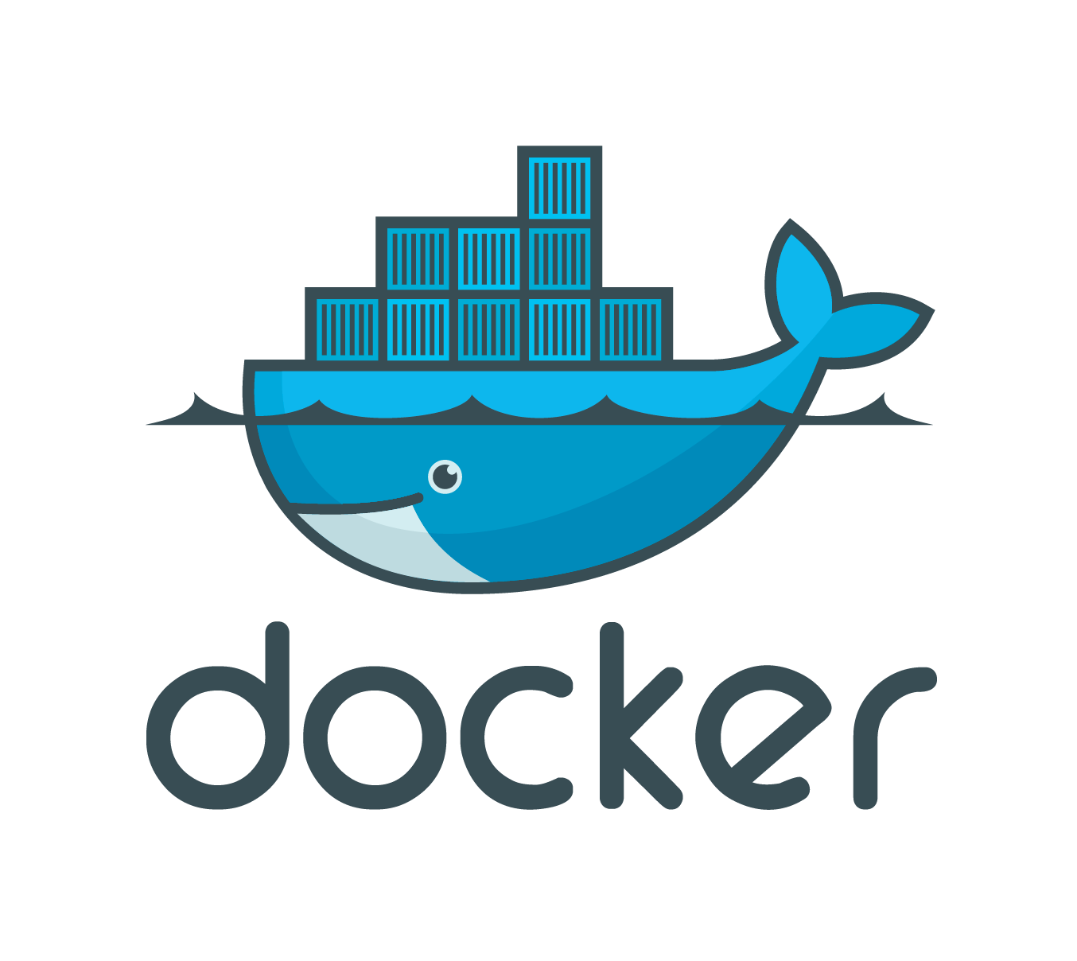
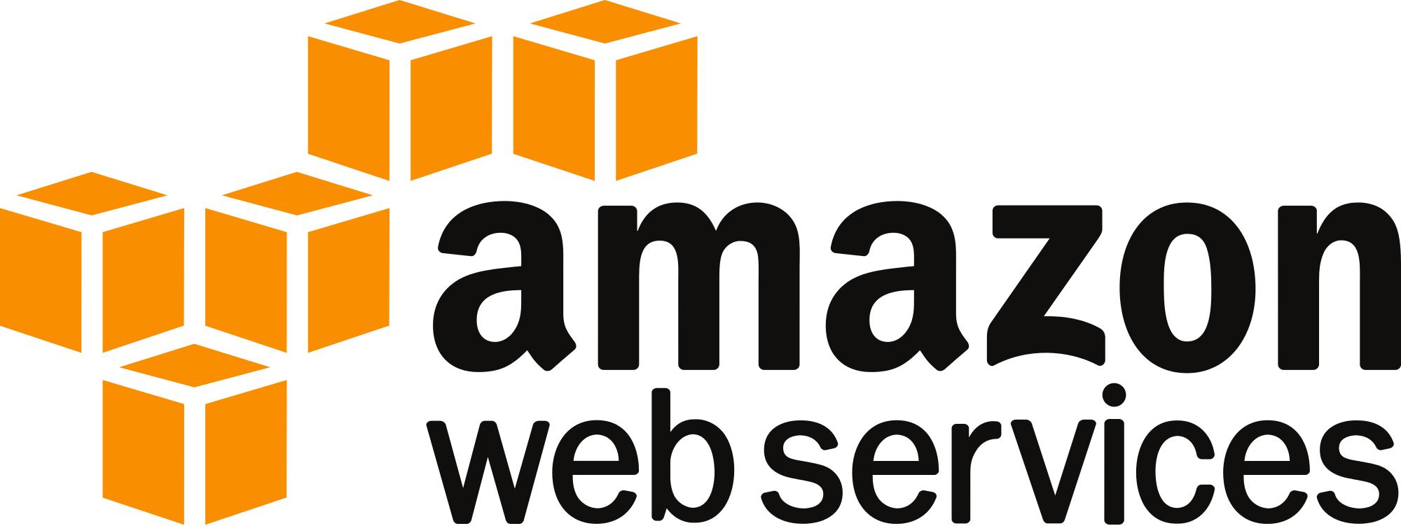
Notes:
We have teams deploying Node apps to Heroku. Others are writing lambdas on AWS, in Node, Java, or Go. Some teams deploy one application per VM using puppet or ansible. Others are using containers on ECS or k8s.
That diversity of approach means we don’t currently have a team responsible for working on deployment platforms. The delivery groups either adopt or adapt something already in use or they build their own platform.
There’s an interesting balance of course between the cost of, for example, creating multiple different deployment platforms vs the speed of not having to wait on another team to add key functionality you need. And that’s why I feel the pendulum is swinging back towards the centre.

Slide 8
Notes:
So what I’m about to talk about just one set of technologies we use at the FT.
The FT’s content platform is made up of many microservices, written in Java and Go, running in containers on CoreOS.
I’m going to tell you about introducing kubernetes into that stack.

Slide 9
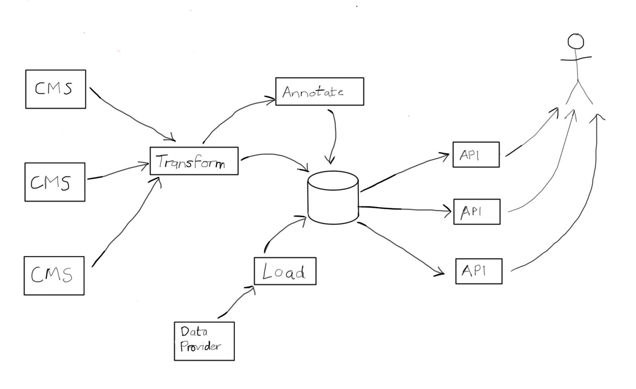
The FT’s Content platform
Notes:
This is a VERY simplified view of what the FT’s content platform does.
We take content from multiple source content management systems, and transform it into a common format. We annotate that content via natural language processing. We load information about the concepts to use in that annotation - millions of concepts. And we make it all available via APIs to our clients both internal and external

Slide 10
This is what it really looks like…
Notes:
I’m not expecting anyone to be able to see the detail here - that’s the point. It’s a really complex architecture diagram.
Because we have a microservice architecture - and boy have we gone for that — the system is made up of 150+ small services, each with a single responsibility.
It’s large, it’s complex…
In those circumstances, migration isn’t a small thing.

Slide 11
Why *did* we migrate to k8s?
Notes:
So we did we need to migrate our stack in the first place?
If you want to have resilience, you need multiple copies of the same service, and they need to be running on different underlying VMs. Cluster orchestrators like kubernetes can handle that for you, providing automated deployment, scaling, and management of containerized applications.
This is all functionality you need when operating containers. So what did we have doing that before?

Slide 12
Mid 2015: a hand-rolled container stack
Notes:
Well, we started running containers, meaning docker, in production in mid 2015.

Slide 13
http://sirupsen.com/production-docker/
Notes:
I’d say running docker in production at that point was pretty leading edge. Even people successfully using docker in production had a list of issues they still felt needed to be addressed.
There were products you could use, but to put them all together into a working platform for your needs was challenging.
We had to build a lot of things ourselves.

Slide 14
CoreOS + cluster-aware tools + our own services
Notes:
We chose to run fleet on CoreOS and wrote some other necessary components as microservices.
We chose CoreOS because it is designed from the ground up to manage deployment of docker containers, came with various cluster-aware tools out of the box and required little learning beyond knowing about current standard linux tools - although it is worth noting that it was only a subset of our team that DID know much about these tools…

Slide 15
Cluster management through fleet and systemd
Notes:
Systemd is a system and service manager. You can define service files for your service, and systemd will then run the service for you
Fleet - is a cluster manager that controls systemd at the cluster level

Slide 16
Host-based routing using vulcand
Notes:
Vulcand is a programmatic load balancer that we used for http routing.
We used Etcd - a distributed key value store - to store the configuration for the routing.
And we wrote a service to take human readable, human maintainable configuration for this and convert into vulcand config.

Slide 17
Deployer written in Go
Notes:
We wrote a service to do deployment.
All the systemd service files were in a single repository and to deploy new versions of services, you updated a single yaml file to change the deployed version and checked it into git. The deployer would pick up this commit and deploy the matching docker image.

Slide 18
https://medium.com/wardleymaps
Notes:
So why did we have to build all these things?
Simon Wardley is an IT strategist - I recommend you watch his KubeCon Europe keynote, the video is online.
He talks about how successful technology goes through a maturity curve. It starts off as something for experts -> ubiquitous -> a product you can buy -> eventually a commodity
A good example from a long time ago is electricity - we wouldn't dream of building our own power stations now
A more recent example is the evolution of the cloud. Computing is a commodity now.
Docker and associated technologies in 2015 were nearer the left hand side than the right hand side.

Slide 19
Spend your innovation tokens wisely
Notes:
The Etsy engineering team have got a lot of interesting things to say about how to approach building technology solutions.
They talk about innovation tokens - the concept that there is a limitation on the amount of new and innovative stuff you can do at any one time - I mean, you could do more, but you’re unlikely to be successful.
Imagine you have a limited supply of innovation tokens in your wallet. You get to choose what stuff you spend them on. Use a brand new NoSQL database - you’re using an innovation token. Choose a new programming language? Same thing.

Slide 20
Benefit vs risks
Notes:
Building your own container cluster orchestration definitely involves spending an innovation token… so why did we do it?
Well, because for us, the benefits outweighed the risks.

Slide 21
Late 2013: microservices
Notes:
We started building the content platform late in 2013. It was one of the first microservices-based systems we built at the FT - made possible because for the first time we had the ability to spin up new VMs in minutes.
And it worked well for us - it decreased the time to get changes out because we released nearly 200 times as often, and with a much lower percentage of failed releases.
And forced us to automate, automate, automate….

Slide 22
One service per VM
Notes:
But we were using an internal deployment platform which deployed each instance of a service to its own VM.

Slide 23
*Lots* of infrastructure provisioning
Notes:
For resilience, we ran multiple instances of a service, in each of two regions, in production, staging and development environments.
This meant provisioning at least 10 VMs for a new service. And this took just enough time to be annoying.

Slide 24
Inefficient use of resources
Notes:
And running each service on its own VM is an inefficient use of resources.
Microservices don’t use up the CPU or memory of even the smallest VM and that’s costly.

Slide 25
Containerisation made sense
Notes:
So containerisation made sense.
After we introduced containers, we could easily run multiple services on each VM.
We ended up running our services on 8 extremely large VMs per region, rather than 300 small VMs, which…

Slide 26
~40% reduction in AWS costs
Notes:
… was about a 40% reduction in AWS costs

Slide 27
Many fewer steps to start running a new service in production
Notes:
And deploying a new service to production didn’t involve any infrastructure provisioning, we just had to build the service file. It was much quicker and less error prone.

Slide 28
But: supportability of an in-house platform is a challenge
Notes:
However, the gains we got were offset by some other things. If you build it yourself, you have nowhere else to go for help
Documentation - particularly of decisions made and why - is very rarely a priority
In our case, most of the containerisation work was done by a small group of developers and integration engineers - and the key members of that group ALL moved on from the FT over a few months in 2016.
When THAT happens, you end up supporting something you don’t *really* understand

Slide 29
Technical debt
Notes:
There were limitations in our platform.
This was true technical debt, because we consciously accepted that we would have some pain points because some stuff we really wanted to do was just a bit too difficult.
But eventually, the interest on that technical debt starts to hurt you.

Slide 30
- routing complex and error prone
Notes:
Our approach to routing was complicated, people often made mistakes when adding new routes, and when they did, they could break all the rest of the routing too.

Slide 31
- limited load balancing
Notes:
We wanted automatic load balancing - fleet would redeploy services if we lost a VM but it wouldn’t rebalance services if one VM was CPU or memory bound

Slide 32
Choose boring technology
http://mcfunley.com/choose-boring-technology
Notes:
This is a great blog post from Dan Mckinley of Etsy, covering innovation tokens among other things.
The flip side of innovation tokens is that we should choose boring technology most of the time.
Boring doesn’t mean bad. Boring technologies are things lots of people use successfully, letting them focus on the things that are differentiators for their companies.
New and innovative technology is exciting, but the capabilities may not be well understood - and more importantly, the failure modes are not likely to be well understood. You want boring in software you’re operating.

Slide 33
By late 2016, tools were maturing
Notes:
When we started using containers, we didn’t have a boring alternative to choose. But at the end of 2016, you could look around and see people successfully using cluster orchestrators in production.

Slide 34
https://medium.com/wardleymaps
Notes:
Things were moving from custom built to product, and even towards commodity
You need to take advantage of these moves. Once something is available as a product, you really only want to be building that yourself if it is CORE to your business.

Slide 35
The FT is not a cluster orchestration company
Notes:
We’re a news organisation. And that’s where we should be focussing our innovation, if possible.

Slide 36
Late 2016: Consider the alternatives
Notes:
We ran a workshop and evaluated a few alternatives in the cluster management and orchestration area

Slide 37
Goals:
- remove roll-your-own stuff wherever possible
- simplify routing/better load balancing
Notes:
We focussed on the things we struggled with the most

Slide 38
Metrics for success:
- amount of time spent keeping cluster healthy
- number of sarcastic comments on slack
Notes:
These are the actual metrics we agreed in the workshop
When things went wrong with our stack, it was sometimes hard to diagnose the problem and fix it - and there was no-one else to ask.
The slack metric is totally serious. If you’re interested in developer morale, it’s one way to pick up how people are feeling. We had a lot of eye rolling when people had to manually intervene to get things fixed up. People were pretty fed up.

Slide 39
Opted for kubernetes
Notes:
We preferred it to the other things we assessed, and we also liked that multiple cloud providers were starting to support k8s… we hoped it would become an emerging standard.

Slide 40
Notes:
Early in 2017 Liz Rice ran this poll - it looked like people were using k8s successfully. *AND* that we’d be able to learn from other people’s experiences.
The later announcement of AWS’s EKS was also a nice confirmation that we were thinking on the right lines. All the main cloud providers now have a managed k8s solution.

Slide 41
Notes:
And then coreos announced they were dropped active development on fleet…
And that in February 2018, it would no longer be included in Coreos updates.
At the time, this felt like quite a long way in the future…. but it meant we HAD to migrate.
But coreos’ recommended approach was to move to k8s, which was comforting.

Slide 42
Using leading edge technologies requires you to be comfortable with change
Notes:
At the FT we often work at the leading edge of technology.
You can get a lot of benefits from doing that - that move to microservices and continuous deployment in 2013 meant we do over 2000 releases a year compared to 12 with the previous generation system. Releasing that often lets us experiment much more.
But sometimes being at the leading edge means you need to change your technology stack because you tried something innovative and it didn’t work so well. Or because now that area has matured and you can buy something in to give you the same benefits. And you should expect to have to do that some of the time.

Slide 43
Shouldn’t be (too) scared about making the wrong decision
http://uk.businessinsider.com/jeff-bezos-on-type-1-and-type-2-decisions-2016-4
Notes:
Jeff Bezos says there are two types of decision…
Type 1: not reversible and you have to be careful making them
Type 2: like walking through a door - you can always go back
The danger is that people end up using the heavyweight decision making process you need for Type 1, for decisions that are reversible. We built our own container stack because it was the right decision at that time. Now we’ve moved onto a different stack, because that seems like the right thing now.

Slide 44
Switching horses midstream
Notes:
But even having good reasons to do the migration, it was still a major challenge…
You don’t want to change horses midstream. You’ve got enough other stuff going on.

Slide 45
At the start of this migration we had 150 services
Notes:
And we had a LOT of services live, in production and under active development.

Slide 46
Lots of other work going on at the same time
Notes:
There were five other teams delivering new functionality.
And the work all those teams were doing had complicated interdependencies - this is a diagram we created for that work during 2017, to map dependencies between different streams of work.
This was fiendishly complex. And the k8s migration team had to try to get on with things without having a huge impact on any of this.

Slide 47
Complications of running in parallel
Notes:
If you’re building from scratch, you can build the platform with a few services in it. You don’t need everything
But some of the stuff we most wanted to know we could support on k8s was around the complicated routing and failover logic we wanted to replicate - so we needed to deploy a large proportion of our services.
And that took time, which meant we had to run in parallel for quite a long time.

Slide 48
We had well over 2000 code releases while running at least part of the stack in parallel
Notes:
Even if it takes 10 minutes extra to deploy to both, that’s
2000 * 10 = 20,000 minutes
= 333 hours
= 47 working days of 7 hours

Slide 49
Decisions, decisions, decisions…
Notes:
We had to make some decisions about HOW to run in parallel - how to make changes for one stack or for the other. How to deploy. How to keep things in sync between the two stacks.

Slide 50
Separate branches vs if/else in code?
Notes:
The first decision was about where to commit changes for the new stack.
We started off with our k8s changes on a separate branch. This kept the work the migration team was doing separate from the work everyone else was doing, BUT it doesn’t work well if those services are also getting active code changes for other reasons.
Eventually, you have to merge those functional changes in and deploy to the k8s stack. The delivery team doesn’t want to pay that tax - and the k8s migration team doesn’t have the context on this new functionality.

Slide 51
Decision: everything committed to master
Notes:
So we changed our approach - all code had to go onto master. Any difference in behaviour between the old and new stack had to be done via picking the appropriate configuration based on the environment, or even in some cases the appropriate code path…
It meant we had a single docker image for a particular version of the code, and expected people to deploy it to both the stacks.

Slide 52
Separate deployment mechanisms vs a single deployment mechanism?
Notes:
Then we needed to consider deployment.
If you have completely separate deployment mechanisms, you *will* end up with inconsistencies because someone forgot to do both deployments. And with 150 services, you can’t see at a glance whether the versions match. You also don’t want to double the effort of deploying new code.
But running a single deployment pipeline is risky - you *really* don’t want to block an emergency deployment to your live stack because a deployment to the new and experimental stack failed.

Slide 53
Decision: two pipelines, kicked off by the same action
Notes:
In the end, we went with two pipelines, both kicked off by the same single action in github - tagging a release.
The last step of deployment to production for each of the stacks involved manual action, so the team also wrote a script to compare versions between the two stacks. It was run manually - we never got round to automating it - mostly by one of the developers on the migration team, telling people when they hadn’t finished off a deployment.

Slide 54
How much testing to do?
Notes:
The approaches we chose meant we were deploying functional changes into both stacks… and deploying to production when the only change to an app was to make it possible to run the app on k8s.
We prioritised the live stack - our functional testing for new stuff was largely done there, with a small amount on sanity testing on the k8s stack.

Slide 55
Decision: rely on automation to help reduce risk
Notes:
We used automation to help here.

Slide 56
End-to-end monitoring of publishing
Notes:
TODO add the diagram for the google drawing in
We already had a service to do end-to-end monitoring for publishing in both stacks, so we could tell if something failed. We ran a service on our old stack that passed all publishing events onto the new stack. Then the monitoring worked for both.

Slide 57
Load replicator running against the new stack
Notes:
For reading from APIs, we used something we’d already written for applying realistic load in our staging environment - a load replicator. This would make realistic requests to all APIs, applying load. It would have been even better if we’d been replicating real traffic - that’s something we’d like to build in future.
Towards the go live point, we had a big end to end testing effort on the k8s stack.

Slide 58
Doing anything 150 times takes time
Notes:
Even spending 30 minutes per service on a task means the whole task will take 10 working days
150 * 30 = 4500 minutes
= 75 hours
= 10 days

Slide 59
Changes per service weren’t *that* big
Notes:
The changes we made per service weren’t large

Slide 60
Migrating from systemd service files to helm charts
Notes:
These were pretty standard between services so this was generally straightforward.

Slide 61
Integrating the service into a templated jenkins pipeline
Notes:
This was heavily templated with only small changes needed per service to hook the service into the pipeline template.
We moved away from our previous approach where deployment was based on git merges into the branch for an environment, because although this approach was simple and quick, developers had to merge between branches to get changes into lower environments, which sometimes involved some git fun - and you would pull all other production changes into your environment, which could mean a one line change in your own service took half an hour of fixing up configuration problems with everything else that had changed.
The risk of moving to the pipeline is that nothing forces lower environments to keep up to date with all the changes every team is making automatically - but in fact with k8s we don’t really have long lived team environments any more. This is because problems are now much more likely to be code based than deployment or config based, and so there is much less chance of breaking the environment for other people.
The use of a template is because we want to be able to change the pipeline in one place, not 150, if we want to do any other improvements.

Slide 62
Good to get everyone involved - “Helm days”
Notes:
We wanted everyone on the team to understand the new platform, and we didn’t want the team doing the work to have to spend a month doing the same repetitive tasks over and over.
We got every developer on our teams involved. We had a full day of creating helm charts for each service - helm day. It was slow going, which is why we ended up having more than one, but it got us good feedback from everyone, and meant they understood the new tools.
Clearly, this has an impact on other work those teams should have been doing… our product owner understood why we were doing this though

Slide 63
Discovered a lot of ‘broken’ things
Notes:
Our biggest problem though was it took a lot longer than 30 minutes on average to make changes and deploy the services to both stacks.
There were several reasons for this…

Slide 64
Services that hadn’t been built for a long time
Notes:
You always have bits of your code base that change a lot, and other bits that don’t.
With microservices, that can mean certain services haven’t been built and deployed for a while. In our case, some of them have been working, unchanged, for years.
That means, when you *do* need to change them, you can get hit with unexpected problems.

Slide 65
Go services without vendoring in generally needed work…
Notes:
Go doesn’t have dependency management - Prior to Go 1.5, whenever you built a go app, you got the latest version of any library you were using.
Go 1.5 introduced vendoring, which lets you include local copies of external dependencies in your own code package, meaning that’s the version you’ll continue to use until you decide to change.
Our original Go apps were written before go introduced vendoring. When we needed to build a new release for the changes we needed for the k8s migration, we often had to fix issues caused by this: suddenly, we were picking up a couple of years of changes in the libraries these apps depended on.
The worst example of this, because we used it everywhere, was an incompatible change in the logging library we used, caused by changing case for the package name.
We mostly introduced vendoring as part of this migration - so hopefully we’ll only feel this pain once.

Slide 66
Consider building overnight, even if you don’t deploy every time
Notes:
Another team at the FT builds every service over night - which means you pick up the build problems as they arrive. That would avoid having this big hit - but it’s a small hit, all the time.
This is probably worth doing because you don’t want to have to fix a ton of problems in order to get a critical bug fix or security fix out to production.

Slide 67
Inconsistent or incomplete implementation of standards
Notes:
The FT has quite a few standards for web applications and services.

Slide 68
/__health
/__gtg
Notes:
For example, we have a healthcheck standard saying we need an endpoint at /__health which returns the health of a service.
We also have a gtg standard at /__gtg that should return a 200 only when a service is ready to take traffic.
Both these standards are widely implemented but not, it turns out, always correctly implemented.

Slide 69
/__health timeouts not set correctly
Notes:
For each of our clusters, we have an aggregate healthcheck service, which calls all the healthchecks for other services and understands what it means for the entire cluster to be healthy.
We rewrote this for k8s to take advantage of service level reporting - i.e. to say the service is healthy as long as one of the instances of that service is healthy.
When we rewrote it, we complied with our healthcheck standard around timeouts - and then discovered lots of our services did NOT.
This could mean things being reported as unhealthy because the health check took too long to respond.
Fixing it involved setting appropriately short timeouts in those services, which in some cases involved changing the way those healthchecks worked.

Slide 70
/__gtg endpoints missing or implemented incorrectly
Notes:
Similarly with the /__gtg standard, which we wanted to use to tell us when a service was ready for traffic - it turns out that, because we didn’t rely on this /__gtg endpoint in our old stack, quite a few services had not implemented it.
We also found quite a few services that had implemented it incorrectly, so that the gtg would return 200 when the service was not, in fact, ready to receive traffic.
If you aren’t using something, you don’t know whether it works. If you have a database backup you’ve never restored, you don’t have a backup, you just have a file.
So we had to fix this stuff up

Slide 71
Making sure a service will recover if k8s moves it elsewhere
Notes:
Many of our older apps just expected services they depended on to be up and running when the app started. This was mostly fine before we were using containers, and wasn’t a huge problem with our original stack because services only got moved if the VM died. k8s moves services much more often and we need that to just work.
We need our apps to keep trying to connect. It’s sensible to do that with some kind of exponential backoff so you don’t hammer a service that is starting up.

Slide 72
Easy to get sucked into making things better
Notes:
If you pick up changes for a service that hasn’t been touched for a while, especially one written when we were new to the go language - it’s easy to decide to fix things up, and that can spiral out into a lot of extra time.

Slide 73
A hard deadline and unpredictable work
Notes:
The fleet end of life announced meant we had a hard deadline and not a lot of confidence that we could estimate the work we needed to do

Slide 74
We’d not done this before
Notes:
It’s pretty hard to work out how long something will take if you’ve not done it before. Even harder if not too many people have done it before.
We’ve been lucky enough to talk to other companies who were or are also adopting k8s. Developers from Monzo and from SkyBet and Gaming in particular were very helpful to us as they were doing similar things, and slightly further along.
We also benefitted from another team at the FT who were building their first container stack, also using k8s. They didn’t have the migration issues and could forge ahead. However, we couldn’t do everything the same way as them because some decisions we’d made in the past pushed us in particular directions.

Slide 75
See also https://lizkeogh.com/cynefin-for-developers/
Notes:
The Cynefin framework was developed by Dave Snowden and some of his colleagues to describe different types of problems.
Liz Keogh gave a great talk on this at the FT some time ago and it’s affected how I think about different types of problem, and how I plan for them.
Simple problems are things anyone on your team could solve - our day to day work. You just have to work out what the problem is then do whatever the best practice is to solve it. We have many tasks like this, but fewer large scale bits of work - because solving a problem everyone already knows how to solve is not the way to make money!
Complicated problems require a bit more expertise. If you’ve done it before, you’ll be fine. You probably need to dig into the details to work out the best way to solve it *this* time, but if you’re an expert, you have a few things in your toolkit for this.
Complex problems are things you haven’t done before. Maybe no-one in your organisation has, and so you need to work your way through the problem. The best thing to do is to try something out, analyse the results, and iterate on that.
Lots of the things we were doing as part of the migration fell into the Complex domain. However, now that we’ve got there, many of our day to day operational problems have moved from Complex to Complicated or even Simple, because k8s will handle it for us.
For completion - chaotic is when things are on fire. You do something to see if you can get the situation under control. For me, chaotic problems usually relate to things in production failing in a way that you can’t initially understand. You do something - restart a service, failover to a new region. Then you see if that made things better - and maybe only afterwards do you understand what just happened.
A side note - estimation can work for simple and complicated stuff. It doesn’t really work for the other two. Going back to the innovation token thing - if you are using an innovation token, you’re in the complex region. That’s why you don’t want to use too many - you don’t really know your likelihood of success or how long it is going to take.

Slide 76
Working out what we needed to get done
Notes:
This is a set of tasks we identified after we’d done a lot of the initial work on the platform, and there are things that need to be done for every service vs things that need to be done once, which generally related to the platform.
We also divided this into things that were critical to say we were ready to run the platform, vs things that were a bit more ‘nice to have’

Slide 77
Spike on the risky stuff
Notes:
Our approach was to spike on the risky stuff, the stuff that could stop the whole thing.
We would spend a few days trying something then work out what we’d achieved.
So how do you know what the risky stuff is - it’s simple: what is worrying you?
Things like working out how to do MongoDB backups in the new stack were risky, because we didn’t know what approach would work - the one for our old stack did not work on the new one. They were Complex in the Cynefin model.
Service-related changes generally weren’t as risky but were pretty time consuming: once we’d migrated a few services, that was just a question of working out how long one would take and calculating how many people needed to get involved to hit our deadlines. These were ‘Complicated’ in the Cynefin model

Slide 78
Building a completely new cluster on k8s helped
Notes:
This was almost accidental - we needed to build a new cluster for some of the new functionality we were working on and that team decided to do it straight on k8s rather than the old stack.
It cost them some time because they hit quite a few issues as the first new live users of our new stack - but it helped the overall migration immensely. They solved a lot of problems, and they became power users and eventually advocates for k8s.

Slide 79
Would have been better if…
Notes:
There are lots of small things we could have done differently with this migration, but the single thing we could have changed that would have had the biggest impact…

Slide 80
We’d swarmed on the work
Notes:
…would be to have swarmed on the work all together.
We paid a price for the size of the team, which was mostly small because we hadn’t got enough funding for this work.
The first thing is, it was very hard on that team. They would spend weeks and weeks doing the same task on service after service. It’s hard to stay motivated. They did, and I am in awe of them for that.

Slide 81
The longer you run in parallel, the more overhead for releasing code changes
Notes:
The more times you are releasing code in two stacks. Testing it in two stacks.

Slide 82
and the higher the costs
Notes:
Running in parallel increased our AWS costs.
It’s OK as long as you understand that it’s short term cost and make sure you communicate that *before* someone gets sent a graph like this..
It would have been worse if we hadn’t turned off some of the lower environments on our old stack quite early on…

Slide 83
Not just AWS costs either
Notes:
Because we were running our load replicator, we had both stacks under a lot of load, and sending all their logs to our log aggregator, splunk.
Sending twice as many logs didn’t make us very popular.

Slide 84
Going live
Notes:
So how did it all go?
Well, we went live before Fleet went end of life. Just.
The last few months were quite intense, we got a lot of the wider team to help out, and that had an impact on other stuff we were trying to do. But we got there.

Slide 85
Doing the migration
Notes:
The actual migration between the two stacks went very smoothly. We did the migration via DNS, changing the backends for urls other services already used to talk to us.
For publishing, there is a single notification url.
For API access, it’s all via an API gateway, so we could change the root configuration for all our APIs in that gateway.
We had two small issues during the migration…

Slide 86
The problem with ‘fixing’ things when migrating
Notes:
Firstly, we’d fixed a bug where we weren’t complying with the http spec OR our API documentation, and it turned out we had clients who were relying on that bug.

Slide 87
If there’s a backdoor, someone will find it
Notes:
Secondly, we found we had some clients who were NOT using our integration urls - they were hitting the stack via other routes, using the basic authentication our own services used. In some cases by social engineering a password out of a helpful development team!
This kind of thing can only be found by monitoring the traffic as you move over and following up on anything that still seems to hit the old stack.

Slide 88
The results
Notes:
So did we get the results we were looking for?

Slide 89
A more stable platform
Notes:
A considerably more stable platform. In the month following the go-live in K8S we had 3 production incidents versus 13 in the same time in 2017. Worth noting that in both cases, I’m counting the times where someone had to step in to stabilise the system and recover resilience, not outages.
We’ve had two out of hours calls related to the stack since go live - and in both cases k8s recovered before the developer got to their laptop.
And we overwhelmingly hit our metric of much less complaining in slack

Slide 90
Something where we can learn from others
Notes:
We now have technologies we can google about. We can watch talks, discuss stuff with other companies. Send developers and operations people on training.

Slide 91
Reduction in hosting and support costs
Notes:
Compared to our old containerised stack AND several of the available alternatives . And even with the cost of the migration, we break even in 3 years compared to our old stack.
The Heroku costs here were calculated to show that for our stack, containers is much more cost efficient.

Slide 92
More cost savings:
~ further 35% reduction in AWS costs
~ total reduction vs one service per VM is ~60%

Slide 93
Notes:
So that was our journey - we didn’t start from the easiest place. And we didn’t necessarily end up exactly where we thought we would.. and I think that’s healthy. You should be asking yourself all along - is *this* a good place to stop, do we need to go further?
We learnt a lot along the way. And we have a more stable, cheaper system and a happier team, who are able to spend more time concentrating on building new things rather than supporting our platform.

Slide 94
Thank you!

Slide 95
Questions?
Notes:
If we don’t have time now, I’m happy to talk in the break or afterwards

